Slide 1

Sprint 1 Review
Ameen Mahouch
Kundan Singh Mahato
Akshay Paluri
Muhammad Anas
Hyun Ho Kim

Slide 2
Sprint Goal
Get familiar with project requirements and specifications
Learn Lockout Tagout (LOTO) and Emergency stop Procedure
Operate robot manually using the “TEACH” Mode
Estimate length of robot arm extension
Carry out trials on the movement of all 6 joints
Meet with project stakeholder (Instructor) to go over project specifications

Slide 3
Product Backlog Items
Backlog Item | Estimate (hours) | Actual (hours)
Project Charter | 20 | 20
Robot Initial Configuration | 1 | 2
Safety Procedure | 1 | 1.5
Sprint Review Presentation | 1 | 2

Slide 4
Sprint Backlog for PROJECT CHARTER
Backlog Item | Estimate (hours) | Actual (hours)
Sections 1, 2, 3 | 4 | 4
Sections 4, 5, 6 | 4 | 4
Sections 7, 8, 9 | 4 | 4
Sections 10, 11, 12, 13 | 4 | 4
Section 14 | 4 | 4

Slide 5
Sprint Backlog for Robot initial configuration
Backlog Item | Estimate (hours) | Actual (hours)
MELSEC PLC Configuration | 0.25 | .5
Controller Configuration | 0.5 | 1
Host PC Configuration | 0.25 | .5

Slide 6
Sprint Backlog for Safety Procedure
Backlog Item | Estimate (hours) | Actual (hours)
E-stop | .5 | .5
Lockout Tagout (LOTO) Procedure | .5 | 1

Slide 7
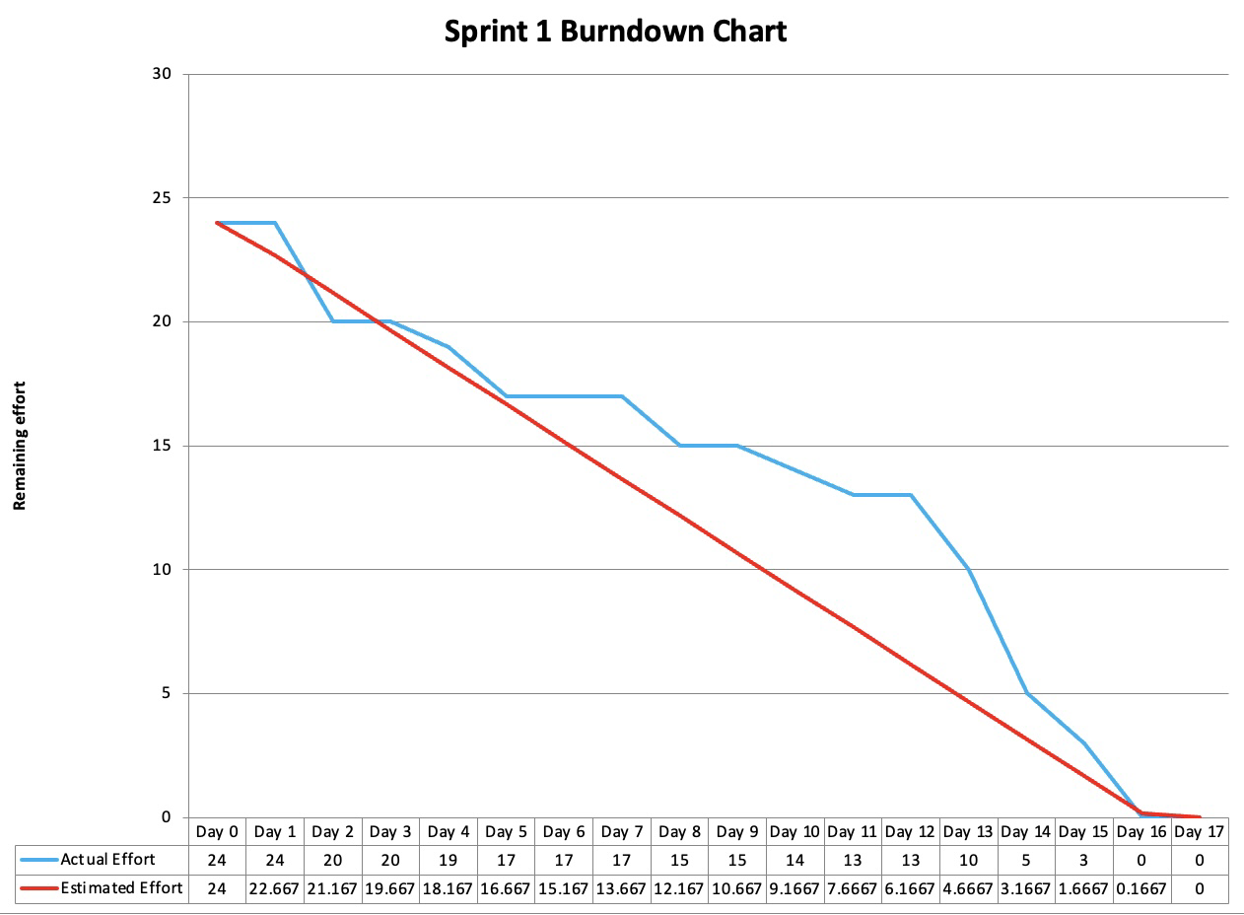
Sprint Burn Down Chart

Slide 8
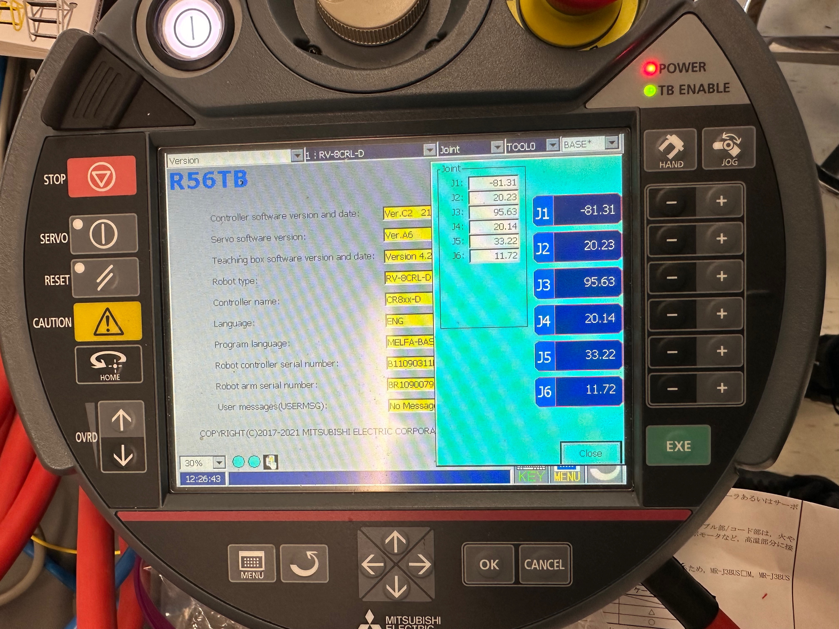
Demo

Slide 9
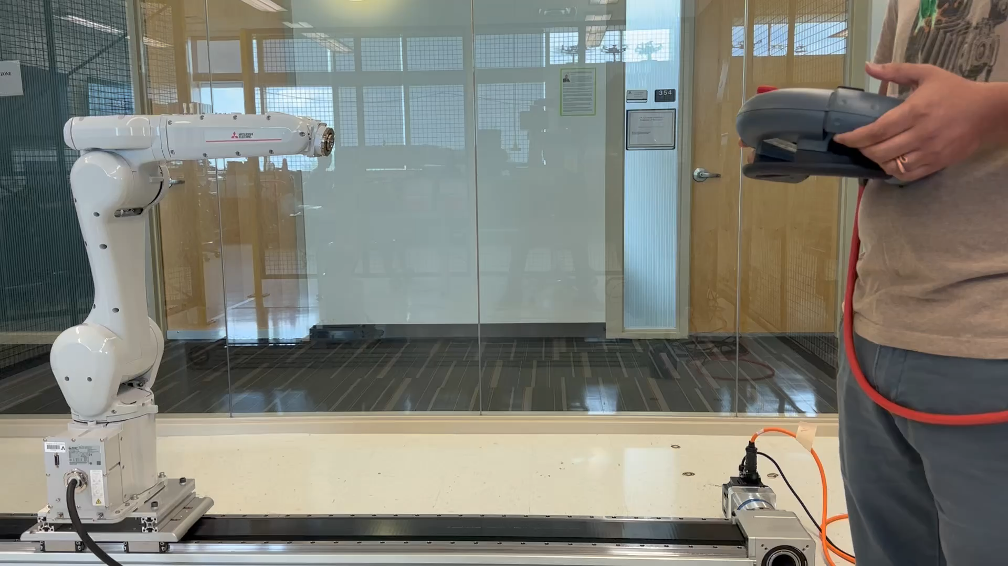
Demo

Slide 10
Questions?

